Slide 1
POCT Urinalysis: Rapid Window to Patient Health

Slide 2
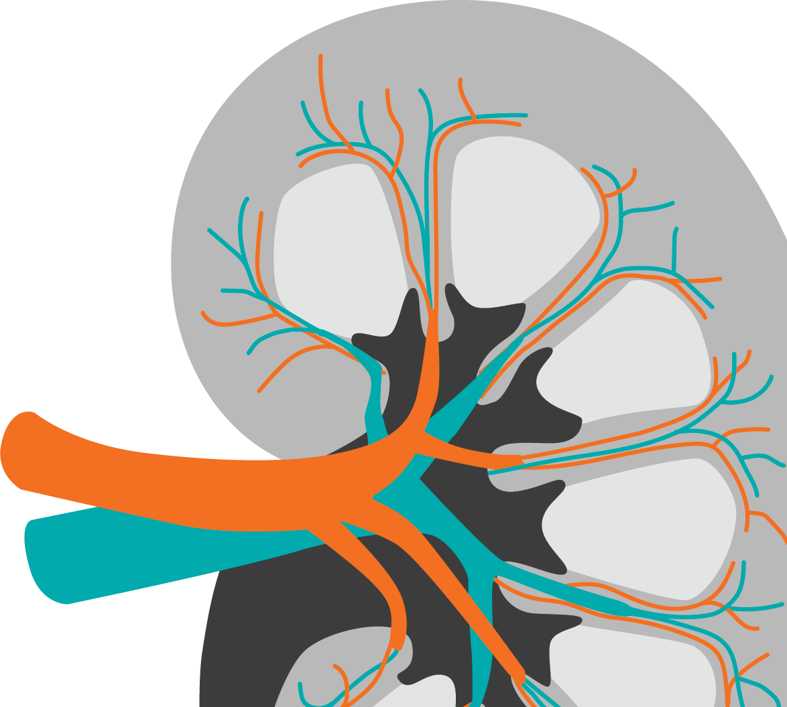
Urinalysis: A Window to Patient Health
Urinalysis has existed for 6,000 years
Information for an inexhaustible list of symptoms and diagnoses
Screen at-risk patients
Assist clinical diagnosis
Monitor disease progression
Evaluate treatment efficacy
Easy
Affordable
Queremel Milani DA, Jialal I. Urinalysis. [Updated 2023 May 1]. In: StatPearls [Internet]. Treasure Island (FL): StatPearls Publishing; 2024 Jan-. Available from: https://www.ncbi.nlm.nih.gov/books/NBK557685/
Notes:
Laboratory medicine began over 6,000 years ago with analysis of human urine. Over time, modern urinalysis methods have developed that give healthcare providers a window into overall patient health. As urinalysis methods continue to become more sensitive and specific, this common and inexpensive laboratory technique will continue to improve diagnostics capabilities.

Slide 3
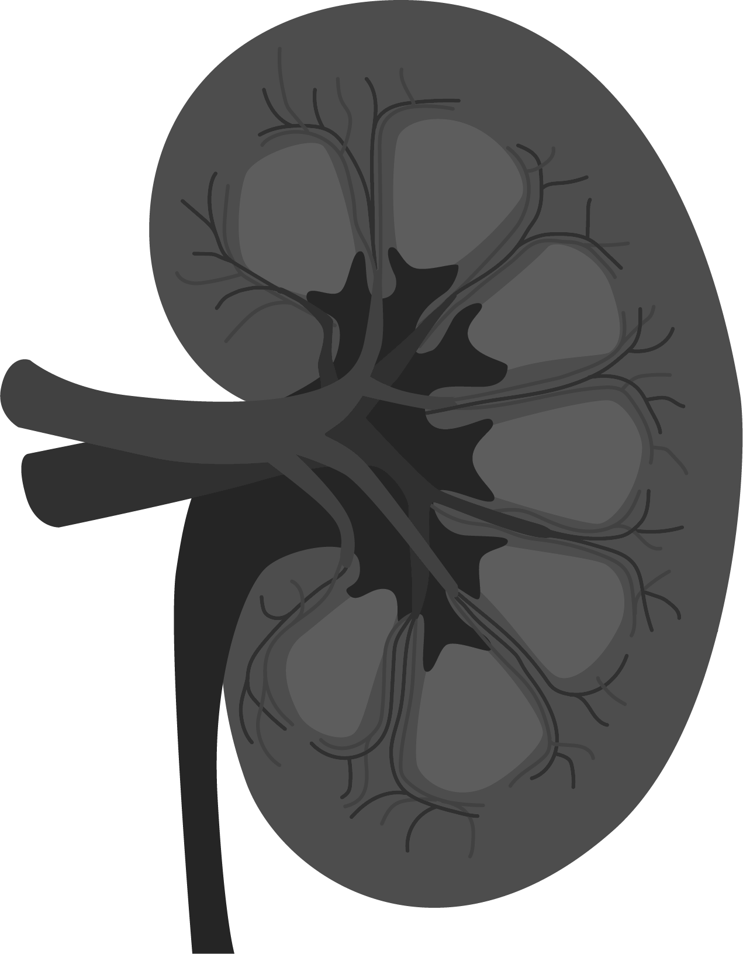
What Can Urinalysis Tell Us?
Kidney disease, diabetes, heart failure, pregnancy, hematuria, uric acid crystals, bacterial infection, urinary tract infection, medication byproducts, hemoglobinuria, myoglobinuria, blood clots, dehydration, overhydration, maple- syrup urine disease, decreased renal blood flow, glycosuria, hepatic failure, SIADH, adrenal insufficiency, diuretic use, aldosteronism, diabetes insipidus, polydipsia, acute impaired renal function, interstitial nephritis, pyelonephritis, anuria, polyuria, proteinuria, Wilson disease, liver dysfunction, diarrhea, vomiting, ketoacidosis, albuminuria, myeloma, Fanconi syndrome, Cushing syndrome, biliary obstruction, viral or drug-induced hepatitis, sterile pyuria cirrhosis, sickle cell disease, thalassemia, fever, glomerulonephritis…
Urine is an unstable fluid that constantly changes composition.
Urinalysis can provide information on kidney disease, diabetes, liver disease, urinary tract infections (UTIs), heart disease, and many other symptoms, diseases, and syndromes.
Queremel Milani DA, Jialal I. Urinalysis. [Updated 2023 May 1]. In: StatPearls [Internet]. Treasure Island (FL): StatPearls Publishing; 2024 Jan-. Available from: https://www.ncbi.nlm.nih.gov/books/NBK557685/
Notes:
The list of symptoms and diagnoses associated with urinalysis findings is long and varied, ranging from obvious issues with the kidneys and urinary tract, to diabetes, cardiac disease, and complications of other organ systems including the gastrointestinal tract and endocrine system.

Slide 4
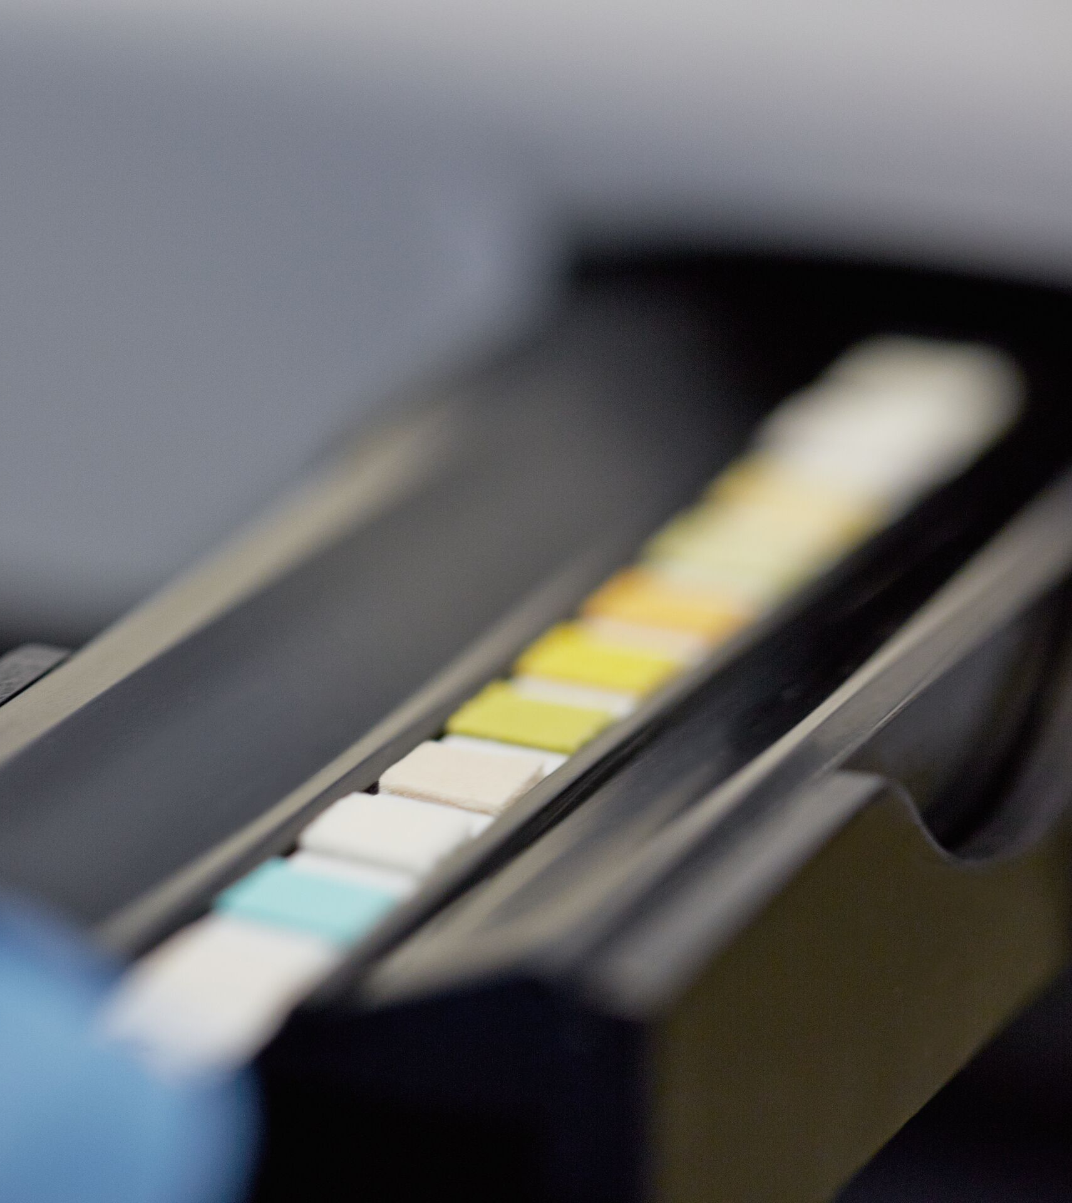
Rapid Evaluation of Multiple Markers
Most urinalysis is done via reagent test strip, sometimes referred to as a dipstick, or cassette.
Accurate collection and reading prevent false positives and negatives.
Reagent test strips can be read visually or by analyzer.
Urine strip analyzers offer greater accuracy convenience, simplicity, and time savings.
Some analyzers connect to patient health records.
Specific gravity | pH | Protein
Glucose | Ketones | Leukocytes
Bilirubin | Urobilinogen | Nitrites
Blood | Albumin | Creatinine
Albumin : Creatinine | Protein : Creatinine | hCG
Queremel Milani DA, Jialal I. Urinalysis. [Updated 2023 May 1]. In: StatPearls [Internet]. Treasure Island (FL): StatPearls Publishing; 2024 Jan-. Available from: https://www.ncbi.nlm.nih.gov/books/NBK557685/
Notes:
Most modern urinalysis is done via reagent test strip (dipstick) or casette. Accurate collection and reading prevent false positives and negatives. While reagent strips can be read visually, urine strip analyzers offer greater accuracy, convenience, simplicity, and time savings. Additionally, some analyzers connect to electronic medical records for seamless integration of patient information.
Common analytes of strip urinalysis include specific gravity, pH, protein, glucose, ketones, leukocytes, bilirubin, urobilinogen, nitrites, blood, albumin, and creatinine. Some strips can assist in the determination of albumin:creatinie and protein:creatinine ratios. Other strips are specifically used to detect hCG in early pregnancy.

Slide 5
Screening At-Risk Groups Leads to Early Identification
Diabetes
Chronic Kidney Disease
Heart Disease
Ketones
Glucose
pH
Protein
ACR
Protein
Albumin
Creatinine
ACR
Specific gravity
pH
Albumin
Creatinine
ACR
Kidney function
Liver Disease
Urinary Tract Infections
Pregnancy
Urinary tract infections
Urobilinogen
Bilirubin
Nitrites
Leukocytes
hCG
Carbohydrate metabolism (e.g, diabetes mellitus)
Jeon J, Kim J. J Transl Med. 2021 Jun 26;19(1):271. Yeo SC, et al. Clin Kid J. 2023;17(1):sfad137.
Khan MS, et al. J Am Coll Cardiol. 2023;81(1):271-282.
https://www.acr.org/-/media/acr/files/practice-parameters/pregnant-pts.pdf. Accessed 5/23/24.
https://www.asahq.org/standards-and-practice-parameters/statement-on-pregnancy-testing-prior-to-anesthesia-and-surgery. Accessed 5/23/24.
Queremel Milani DA, Jialal I. Urinalysis. [Updated 2023 May 1]. In: StatPearls [Internet]. Treasure Island (FL): StatPearls Publishing; 2024 Jan-. Available from: https://www.ncbi.nlm.nih.gov/books/NBK557685/
Liver function
Notes:
One of the benefits of rapid urinalysis is the screening and early identification of multiple chronic and acute health conditions. Urinalysis is commonly used to screen for markers of diabetes, chronic kidney disease, heart disease, liver disease, urinary tract infections, and pregnancy.

Slide 6
Early Treatment & Better Outcomes
Early detection of kidney disease is necessary for effective intervention to delay progression and reduce cardiovascular risk.
Individuals with trace proteinuria are at increased risk for developing diabetes, metabolic syndrome, and hypertension. Early detection via urinalysis allows for prevention education and early diagnosis to improve outcomes.
Bilirubinuria is often the first sign of liver disease in otherwise asymptomatic patients. Early diagnosis of liver disease is key to successful management and improved outcomes.
Negative nitrite and leukocyte esterase levels can rule out urinary tract infection (UTI) with a 99.7% specificity, preventing unnecessary antibiotics and improving antibiotic stewardship.
Shilpak MG, et al. Kid Int. 2021;99(1):34-47. Okada R, et al. Clin Exp Nephrol. 2018 Dec;22(6):1387-1394. Hoilat GJ, John S. Bilirubinuria. [Updated 2023 Aug 8]. In: StatPearls [Internet]. Treasure Island (FL): StatPearls Publishing; 2024 Jan-. Available from: https://www.ncbi.nlm.nih.gov/books/NBK557439/
Wazir H, et al. Cureus. 2023;15(12):e49920. Dadzie I, et al. Can J Infect Dis Med Microbiol. 2019;2019:8642628.
Notes:
Early identification and treatment leads to better patient outcomes. According to KIDGO, early detection of kidney disease is necessary for effective intervention to delay progression and reduce cardiovascular risk. Screening patients for proteinuria may identify individuals at risk for development of diabetes, metabolic syndrome, and hypertension. Early screening and identification of these patients leads to early educational and lifestyle intervention that could improve outcomes. Bilirubinuria is often the first sign of liver disease in otherwise asymptomatic patients. Early diagnosis of liver disease is key to successful management of these patients.
Not all urinalysis screening is for chronic conditions. Acute diagnoses like urinary tract infections (UTIs) can be definitively ruled out with POCT urinalysis instead waiting for urine culture. Urinalysis with negative nitrite and leukocyte esterase findings are 99.7% specific for a negative urine culture. Ruling out a UTI in patients presenting with similar symptoms can reduce the amount of unnecessary antibiotic prescriptions and improve antibiotic stewardship.

Slide 7
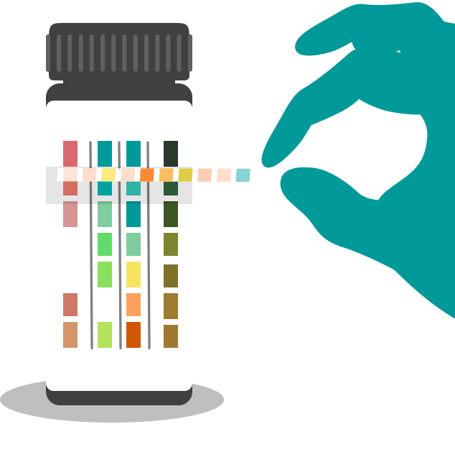
Screening to Improve Health Equity
Social determinants of health lead to healthcare disparities.
Economic instability
Lack of nutrition
Inadequate education
Unsafe physical environment
Limited access to healthcare
Race/ethnicity plays a role in health and diagnosis.
Minorities have higher rates of diabetes, kidney disease, heart disease, hypertension, and obesity.
More likely to be undiagnosed
May be more impacted by social determinants of health
Urinalysis is a rapid and cost-effective way to screen for diabetes, kidney disease, heart disease, liver disease, and other conditions in those most affected by healthcare disparities.
https://www.kidney.org/atoz/content/social-determinants-health-and-chronic-kidney-disease. Accessed 05/20/24. George C, et al. BMC Med. 2022;20(1):247. Kim EJ, et al. J Gen Intern Med. 2018 Jul;33(7):1116-1123.
https://health.gov/healthypeople/priority-areas/social-determinants-health/literature-summaries/access-health-services. Accessed 05/20/24.
Notes:
Early and accurate diagnosis is the key to reducing morbidity and mortality associated with chronic health conditions. Social determinants of health including economic instability, lack of adequate nutrition and education, unsafe physical environments and limited access to healthcare often prevent individuals from obtaining accurate and timely diagnosis and preventative care. Racial and ethnic minority status also plays a role in health. Whether by social determinants or genetics, minorities have higher rates of diabetes, kidney disease, heart disease, hypertension, and obesity than non-minorities in the U.S. and globally. Individuals of racial and ethnic minorities are often more likely to be living with an undiagnosed chronic health condition.
Urinalysis is a rapid and cost-effective way to screen for diabetes, kidney disease, heart disease, liver disease, and other conditions in those most affected by healthcare disparities. These tests can be done in a hospital, physician office, community clinic, community health fair, pharmacy, or any number of other locations to improve the rates of screening and diagnosis for underserved patients.

Slide 8
Connectivity with Analyzers Improves Performance
Urinalysis analyzers that connect with electronic medical records can improve both test accuracy and practice efficiency.
Remove subjectivity
Reduce test time
Eliminate transcription errors
Improve documentation
https://www.imperial.ac.uk/media/imperial-college/medicine/surgery-cancer/pstrc/Automation-of-urinalysis-at-the-Point-of-Care-across-ICHT.pdf. Accessed 6/3/24. Young PE, et al. Clin Chim Acta. 2020 May;504:60-63. van Delft S, et al. BMJ Open. 2016 Aug 8;6(8):e011230. Srinivas CN. Pathologist. 2021.https://thepathologist.com/diagnostics/improving-flow-in-urinalysis. Accessed 5/20/24.
Notes:
Urinalysis analyzers read colormetric information on urine strip or dipstick tests. These semi-automated analyzers can remove subjectivity and more rapidly and accurately read and interpret reagent strips than manual reading. Some analyzers offer direct connection to electronic medical records, eliminating transcription errors and improving documentation rates.

Slide 9
Urinalysis Analyzers are Useful to Staff
In practices that currently use POCT urine analyzers to read test strips:
75%
100%
Agree that automated POCT urinalysis improves performance
Believe automated POCT urinalysis is useful in daily work
Young PE, et al. Clin Chim Acta. 2020 May;504:60-63. van Delft S, et al. BMJ Open. 2016 Aug 8;6(8):e011230. Srinivas CN. Pathologist. 2021.https://thepathologist.com/diagnostics/improving-flow-in-urinalysis. Accessed 5/20/24.
Notes:
Urinalysis analyzes are often favored over manual reading in practices that currently use them. A recent survey found that 75% of individuals who currently run POCT urinalysis agree that automated readers improve performance. Of those surveyed, 100% believe that automated POCT urinalysis is useful in their daily work with patients.

Slide 10
Patient Case: Mia
Presentation: A 34-year-old female presents to the emergency department with nausea, vomiting, chills, and 10/10 acute severe abdominal pain the in right lower quadrant. Heart rate 110 bpm, blood pressure 145/72 mm Hg, temperature 100.8 °F.
History: Worsening gastrointestinal symptoms and lower abdominal pain for 4 hours. No previous history of ovarian cysts, endometriosis, or other reproductive disease. Patient does not have a menstrual cycle due to birth control injections. No history of gastrointestinal or renal disease. No recent history of UTI.
Differential diagnosis:
Appendicitis
Kidney stones
Ectopic pregnancy
Ovarian or uterine causes
Imaging:
CT of abdomen and pelvis
Labs:
Urinalysis (strip analyzer)
Urine hCG (strip analyzer)
Serum analysis
CBC & BMP
C-reactive protein
Notes:
Mia, a 34-year-old presents to the emergency department with nausea, vomiting, chills, fever, and acute right lower quadrant pain with a 10 out of 10 severity. Her heart rate is 110 bpm and her blood pressure is 145/72. She has a temperature of 100.8 °F.
She tells the triage nurse that her symptoms had been steadily worsening over the last four hours. She claims no previous history of ovarian cysts, endometriosis, or other reproductive disease. She does not have a menstrual cycle due to birth control injections but denies any symptoms or knowledge of pregnancy. She has no history of gastrointestinal or renal disease and does not report any recent UTIs. Upon examination, her lower right abdomen is extremely tender with good bowel sounds.
The differential diagnosis includes appendicitis, kidney stones, and ectopic pregnancy among other ovarian or uterine causes. The attending orders a CT of her abdomen and pelvis and labs including a POCT urinalysis and hCG via urine strip analyzer, a CBC, BMP, and C-reactive protein.

Slide 11
Patient Case: Mia
Positive Lab Results
Positive urine hCG test was incorporated via analyzer to patient EMR.
Key Points
Urine hCG
hCG
Physician changed imaging order to ultrasound to prevent risk to the developing fetus.
Rapid urine hCG with EHR connectivity altered imaging recommendation.
Findings of urinalysis detected multiple markers of possible kidney stones.
Ultrasound confirmed urinalysis and urine hCG.
POCT urinalysis and hCG via connected analyzer were instrumental to a safe and accurate diagnosis for this patient and her developing pregnancy.
Urinalysis
Specific gravity
Nitrites
Leukocytes
Blood
pH
Imaging & Diagnosis
Identified via transabdominal ultrasound:
4 mm stone in the right proximal ureter
Normal intrauterine pregnancy, 10-week fetus in gestational sac, length 30 mm, heart rate 176 bpm
Serum analysis
Calcium
Notes:
Due to the rapid nature of POCT urine strip analysis, the urinalysis and urine hCG results are obtained within a few minutes of sample collection. The analyzer imports the results into the patient's electronic medical record which flags the result of a positive urine hCG. As a result, the attending changes the imaging order from a CT to an ultrasound to prevent risk to a developing embryo or fetus. Urinalysis is positive for increased specific gravity, nitrites, leukocytes, blood, and altered pH. These results indicate a possible UTI and/or kidney stones. While waiting for the ultrasound results, serum analysis indicates an elevated calcium level.
Transabdominal ultrasound locates a 4 mm stone in the right proximal ureter. There is no indication of appendix pathology. Also noted during the ultrasound is a normal intrauterine pregnancy of approximately 10 weeks. The fetus is located normally within the gestational sac and measures 30 mm, with a heart rate of 176 bpm.
This case illustrates the use of POCT urine strip urinalysis with an analyzer to allow rapid intervention of an imaging order that might otherwise be harmful to a developing fetus in the first trimester. Urinalysis found multiple markers associated with possible kidney stones, supporting the clinical differential diagnosis. Ultrasound then confirmed the findings of kidney stones and pregnancy. The usefulness of a connected analyzer was instrumental to a safe and accurate diagnosis for this patient.

